Slide 1

AI Healthcare Knowledge Assistant using Hybrid RAG
Presented By:
B Vijaya Lakshmi

Slide 2
About Me
I am a postgraduate in Data Science from Bankatlal Badruka College for Information Technology, with a strong interest in Data Science, Machine Learning, Artificial Intelligence, and Generative AI.
I have hands-on experience with Python, SQL, Power BI, Machine Learning, Deep Learning, NLP, LLMs, RAG, LangChain, LangGraph, Agentic AI, MCP, and Prompt Engineering, along with data analysis and visualization.
I enjoy building AI-powered and data-driven solutions using modern technologies to solve real-world business problems, automate tasks, and generate meaningful insights.
LinkedIn: www.linkedin.com/in/bollapalli-vijaya-lakshmi
GitHub: Vijayalakshmibollapalli

Slide 3
Agenda
Introduction
Business Problem
LLM vs RAG
Why Do We Need RAG?
System Workflow
Dataset & Knowledge Base
Data Preparation (Offline Indexing)
Hybrid Retrieval Pipeline
LLM Response Generation
Performance Evaluation (RAGAS)
Results
Advantages & Limitations
Future Enhancements
Conclusion

Slide 4
Introduction
Healthcare information is spread across numerous medical research papers, making it difficult to quickly access accurate and reliable answers. General Large Language Models (LLMs) may generate incorrect or unsupported medical information due to hallucinations and outdated knowledge.
This project develops an AI-Powered Healthcare Knowledge Assistant using Hybrid Retrieval-Augmented Generation (Hybrid RAG). It combines BM25 keyword search, MMR semantic retrieval, HyDE query expansion, Context Compression, and the Groq openai/gpt-oss-20b model to generate evidence-based answers from trusted medical documents.
Technologies: Python, LangChain, ChromaDB, HuggingFace Embeddings, Groq LLM, Streamlit

Slide 5
Business Problem
Healthcare information is distributed across numerous medical journals, clinical guidelines, and research papers, making it difficult for users to quickly access reliable information. Traditional search engines often return lengthy documents instead of precise answers, while general Large Language Models (LLMs) may generate inaccurate or unsupported medical responses due to hallucinations. This creates a need for an intelligent system that can retrieve relevant medical evidence and generate trustworthy, context-based answers.
Key Challenges
Medical information is scattered across multiple research documents.
Searching and reading large documents is time-consuming.
LLMs may produce hallucinated or outdated medical information.
Responses often lack supporting evidence or references.
Reliable healthcare information is essential for informed decision-making.

Slide 6
Large Language Model (LLM)?
A Large Language Model (LLM) is an AI model trained on vast amounts of text data to understand and generate human-like language. It predicts the next word in a sequence, enabling it to answer questions, summarize text, translate languages, and perform many other language tasks.
Examples
ChatGPT
Gemini
Claude
Llama
Advantages
Generates fluent and natural responses.
Supports multiple NLP tasks.
Understands natural language queries.
Fast response generation.

Slide 7
Issues with LLM
Although LLMs are powerful, they have inherent limitations because they rely primarily on their pretrained knowledge.
Key Issues
Can generate incorrect or fabricated information (hallucinations).
Knowledge is limited to the data used during training and may become outdated.
Cannot access newly published information automatically.
Do not inherently provide evidence responses.
Example
An LLM may answer a healthcare question confidently, even if the information is outdated or incorrect.

Slide 8
Retrieval-Augmented Generation (RAG)
Retrieval-Augmented Generation (RAG) is an AI framework that combines document retrieval with a Large Language Model. Instead of answering only from its trained knowledge, the model first retrieves relevant documents and then generates an answer based on the retrieved information.
Benefits
Produces evidence-based answers.
Reduces hallucinations.
Uses up-to-date and domain-specific documents.
Improves reliability and trustworthiness.

Slide 9
Why Do We Need RAG?
Answers are based only on the model's existing knowledge.
The model cannot search medical research papers while answering.
Important or recent information may be missing.
Users cannot verify where the answer came from.
This reduces the reliability and trustworthiness of the response.
Solution
RAG first retrieves relevant information from trusted medical documents and then generates the answer, making the response more accurate and reliable.

Slide 10
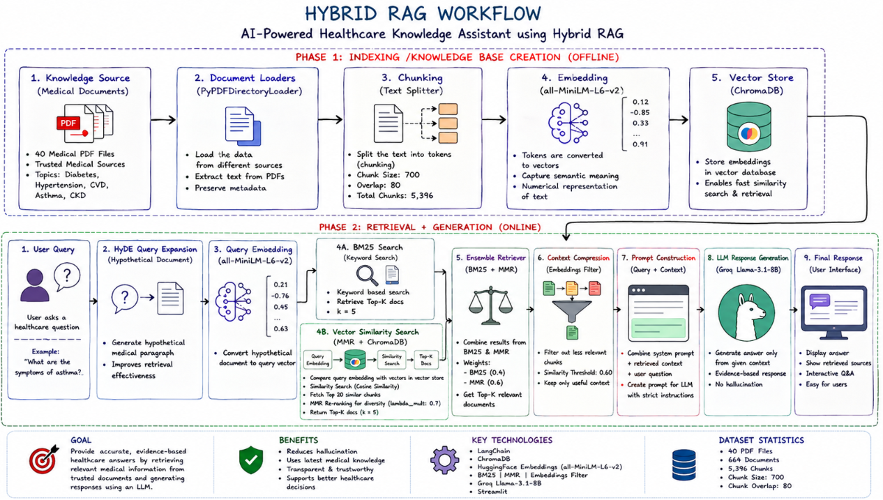

Slide 11
Dataset (Knowledge Base)
Medical Knowledge Base
The knowledge base was created by collecting 40 medical review articles from trusted healthcare sources such as PubMed Central (PMC). These documents provide comprehensive and evidence-based information on common chronic diseases.
Disease Categories
Diabetes
Hypertension
Cardiovascular Disease
Asthma
Chronic Kidney Disease
Dataset Statistics
40 Medical Research PDFs
664 Documents Loaded
5,396 Text Chunks Generated
Why This Dataset?
Built from trusted and publicly available medical literature.
Covers diagnosis, symptoms, risk factors, treatment, complications, and prevention.
Forms the knowledge base used by the RAG system to retrieve relevant medical information and generate evidence-based responses.

Slide 12
Data Preparation (Offline Indexing)
Document Loading
Medical research PDFs are collected from trusted healthcare sources.
The text is extracted from each document for further processing.
Text Chunking
Large documents are divided into smaller overlapping text chunks.
This improves retrieval accuracy and preserves context.
Text Embedding
Each text chunk is converted into a numerical representation (vector).
These vectors capture the semantic meaning of the content.
Vector Database
The generated vectors are stored in a vector database.
This enables fast and efficient similarity-based document retrieval.
Output
40 Medical PDF files
664 Documents
5,396 Text Chunks

Slide 13
Hybrid Retrieval Pipeline
How the Retrieval Pipeline Works
The retrieval pipeline is designed to identify the most relevant medical information before generating a response.
BM25 performs keyword-based search to find documents containing important search terms.
MMR enhances retrieval by identifying semantically similar and diverse documents.
The results from both methods are combined to improve retrieval quality.
Context Compression removes unnecessary information and keeps only the most relevant content.
HyDE Query Expansion generates a hypothetical document to improve semantic retrieval, especially for complex medical queries.
Outcome: The retrieved context is accurate, relevant, and concise, allowing the Large Language Model to generate trustworthy and evidence-based healthcare responses.

Slide 14
LLM-Based Answer Generation
After retrieving the most relevant medical information, the system sends the user's question along with the retrieved context to the Large Language Model (Groq openai/gpt-oss-20b ). The model generates a clear, accurate, and evidence-based response using only the retrieved medical documents.
Key Features
Generates responses using retrieved medical context only.
Produces accurate and evidence-based healthcare answers.
Minimizes hallucinations by grounding responses in trusted documents.
Delivers fast and consistent responses.
Final Output: Reliable Healthcare Answer with Supporting Context

Slide 15
Evaluation Using RAGAS
To measure the quality of the Hybrid RAG system, the RAGAS framework was used. It evaluates both the retrieval performance and the quality of the generated responses.
Evaluation Metrics
Metric | Purpose
Answer Relevancy | Measures how well the generated answer matches the user's question.
Context Precision | Measures whether the retrieved documents are relevant to the query.
Faithfulness | Checks if the answer is supported by the retrieved context and is free from hallucinations.
Context Recall | Measures whether the retrieved context contains all the necessary information to answer the question.

Slide 16
RAGAS Evaluation Results
Metric | Score
Answer Relevancy | 0.87
Context Precision | 0.90
Faithfulness | 0.94
Context Recall | 0.84
Performance Summary
Highly relevant answers to user queries.
Accurate retrieval of medical documents.
Minimal hallucinations due to grounded responses.
Reliable evidence-based healthcare information.

Slide 17
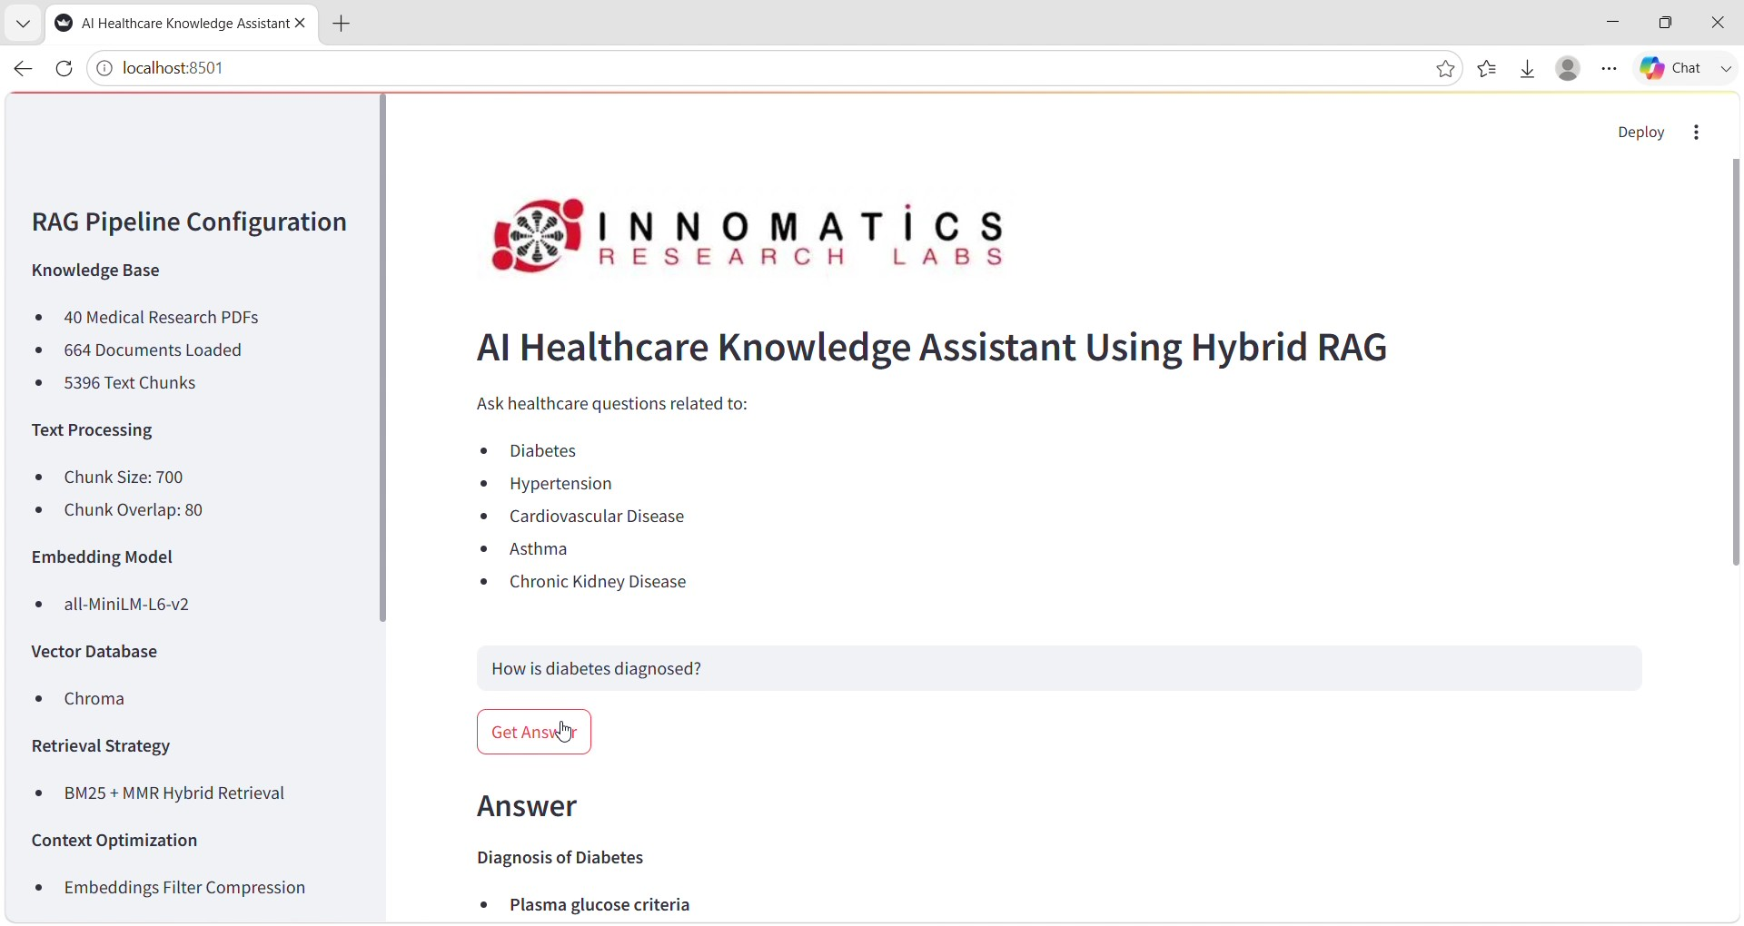
Deployment
For deployment Streamlit build a simple UI where users can input data and get predictions.

Slide 18
Challenges Faced
Challenge | Solution
Large medical PDF files required significant preprocessing time. | Split documents into smaller chunks (700 characters with 80-character overlap).
Retrieving irrelevant or duplicate document chunks. | Implemented Hybrid Retrieval using BM25 + MMR and Context Compression.
LLM hallucinations and unsupported answers. | Restricted the LLM to generate answers only from the retrieved context using prompt engineering.
Finding semantically relevant documents for complex queries. | Used HyDE Query Expansion to improve retrieval quality.
Managing large numbers of embeddings efficiently. | Stored embeddings in ChromaDB for fast similarity search.
Evaluating RAG system performance. | Used the RAGAS framework to measure Answer Relevancy, Context Precision, Faithfulness, and Context Recall.
Maintaining fast response time. | Used Groq openai/gpt-oss-20b, which provides low-latency inference.

Slide 19
Advantages & Limitations
Advantages
Evidence-based responses
Reduced hallucinations
Hybrid search improves accuracy
Easy to update knowledge base
Interactive web application
Limitations
Limited to the uploaded medical documents.
Supports only text-based PDF documents.
Cannot analyze medical images such as X-rays or MRI scans.
Performance depends on the quality of the knowledge base.

Slide 20
Future Enhancements
Voice-Based Interaction – Enable users to ask healthcare questions using voice.
Multilingual Support – Support multiple regional and international languages.
Medical Image Analysis – Integrate X-ray, MRI, and CT scan interpretation.
EHR Integration – Connect with Electronic Health Records for personalized healthcare assistance.
Expanded Knowledge Base – Add more diseases, clinical guidelines, and updated medical research papers.
Cloud Deployment & Advanced Medical LLMs – Deploy the system on the cloud and integrate fine-tuned medical language models for improved accuracy.

Slide 21
Conclusion
Successfully designed and implemented a Hybrid RAG-based Healthcare Assistant.
Retrieved information from trusted medical documents instead of relying only on the LLM.
Improved retrieval quality using BM25, MMR, HyDE, and Context Compression.
Generated reliable, evidence-based responses with minimal hallucinations.
Built a user-friendly Streamlit application for healthcare question answering.

Slide 22

THANK YOU

